Slide 1
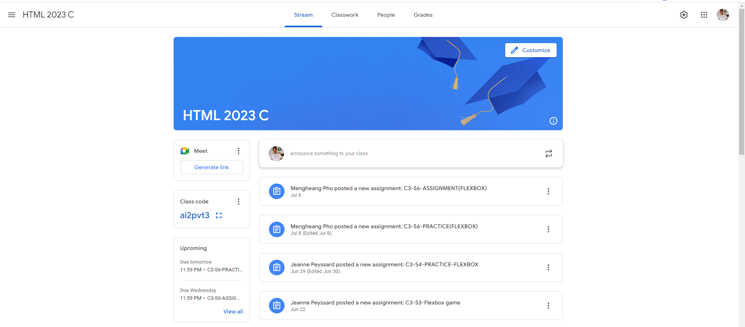
Name: Ly Sreypich
Group: 01
Identify root components of website below
Flex 0
nav
content
header
Flex 0
Flex 1

Slide 2
Left-nav
Center-nav
Right-nav
Flex 1
Flex 1
Flex 1

Slide 3
Banner-Section
Flex 0
Announcement/Post-Section
Flex 1

Slide 4
Flex 0
Flex 1
Announcement
Post-Section

Slide 5
Announcement
Flex 0
Posting
Flex 1

Slide 6
Flex 0
Flex 1
Create-post
Profile-img

Slide 7
Flex 0
Flex 1
Icon
Post-content

